Slide 1
LANGUAGE TRANSLATOR
Name :- Soriya Milan N.
Roll No :- IT-110
ID :- 17ITUOS003
Name :- Suhagiya Yash M.
Roll No :- IT-111
ID :- 17ITUOS011

Slide 2
Language description
Our language can perform calculator(scientific) based mathematical operation.
For example our language perform addition, subtraction , multiplication , division , modulo , power , square root, logarithmic function and other trigonometric function.
If user want to perform addition so simply write “31+64” then our language gives the output as “95”.
Our Yacc and Lex file given in the following slides.

Slide 3
COMPILATION PROCESS
flex filename.l
It will give lex.yy.c file.
bison -dy filename.y
It will give y.tab.h and y.tab.c file.
gcc lex.yy.c y.tab.c -o name
It will give name.exe file.
Now run name.exe file and enter the inputs.
Link for the code:- github.com/yashsuhagiya/flex-and-bison-based-calculator

Slide 4
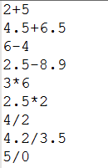
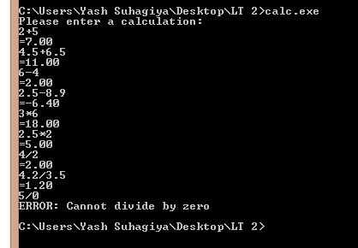
all possible inputs and outputs

Slide 5
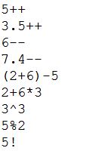
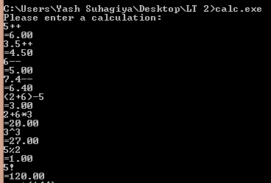
all possible inputs and outputs

Slide 6
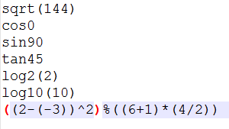
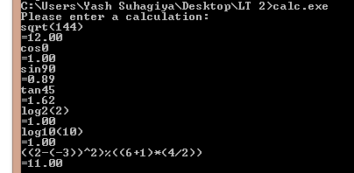
all possible inputs and outputs

Slide 7
Thank you !!

